Slide 2
The EDQM Certificate of Suitability (CEP) Procedure
Cristian SAMPAOLESI
Certification of Substances Department (DCEP)
EDQM, Council of Europe
22 November 2019, Pavia - Italy

Slide 3
EU legislation and certificates of suitability
EU Directives 2001/83/EC and 2001/82/EC, as amended, on medicinal products require active substances (APIs) to comply with the Ph. Eur. monograph if there is one
Claiming compliance with a Ph. Eur. monograph is not enough
The applicant shall demonstrate the suitability of the Ph. Eur. monograph to control the quality of the API used
…“where the active substance is the subject of a monograph of the Ph. Eur., the applicant can apply for a certificate of suitability that, where granted by the EDQM, shall be presented in the relevant section of the CTD Module. Those certificates of suitability …are deemed to replace the relevant data of the corresponding sections described in the Module…”

Slide 4
The CEP procedure
CEP = Certificate of Suitability to the monographs of the European Pharmacopoeia
An international platform for:
Assessment of the quality of substances for pharmaceutical use (mainly APIs), with reference to monographs of the Ph. Eur.
Coordination and conduct of GMP inspections of API manufacturers
Source of information to update Ph. Eur. monographs
Managed by the EDQM
Open to any manufacturer of pharmaceutical substances regardless of geographical origin

Slide 5
The CEP procedure (2)
CEPs are not mandatory
In the EU, up to the applicant to choose the way to provide data on the quality of an active substance:
Certificate of suitability (requires a Ph. Eur. monograph, APIs and excipients)
Active substance Master File (ASMF) (For Ph. Eur. and non-Ph. Eur. APIs)
Full details of manufacture in marketing authorisation application (For Ph. Eur. and non-Ph. Eur. APIs)
The data to be submitted are the same, irrespective of the route selected

Slide 6
The CEP procedure provides
Centralised assessment
Easier management of marketing authorisation applications and respective variations: CEP replaces main part of 3.2.S of CTD
CEPs are increasingly accepted worldwide
Save time and resources!

Slide 7
Scope
Chemical substances, fermentation products, herbals, covered by a monograph in the Ph. Eur.
To demonstrate:
that the quality of a substance is suitably controlled by the Ph. Eur. monographs (with additional tests, if needed)
that the substance quality is in compliance with ICH & EU requirements (related substances, mutagenic impurities, residual solvents, elemental impurities, etc.)
➔“Chemical CEP” or “Herbal CEP”
TSE (Transmissible Spongiform Encephalopathy) risk materials (with reference to the General Monograph “Products with TSE risk”)
To guarantee compliance with the General Monograph
➔“TSE CEP”

Slide 8
Who is involved
Steering Committee
16 members, representing the main authorities & working groups in Europe and Ph. Eur. member states
Takes decisions on scope, makes links with regulatory groups and adopts EDQM guidelines
Technical Advisory Boards (TAB)
Chemical, TSE, Herbals
Experienced assessors taking part in the procedure
Prepare policies, guidelines, take decisions on technical issues…

Slide 9
Who is involved (2)
Assessors:
from National competent authorities from Ph. Eur. member states, and international partners
Skilled in the relevant domain (chemical evaluation, TSE risk, herbal products, toxicologists…)
About 100 assessors from 25 countries, including Australia and Canada, and also from EDQM
Come regularly to EDQM premises for the evaluation of dossiers together with EDQM colleagues

Slide 10
Who is involved (3)
Inspectors:
# 30 inspectors from supervisory authorities from 16 EU/EEA countries + Switzerland
Perform inspections with EDQM
EDQM Certification Department
located in Strasbourg, France
#45 people: assessors, inspectors, scientific and administrative staff
Run the procedure, coordinate the activities and communication

Slide 11
Evaluation of applications and granting CEPs

Slide 12
How to apply for a CEP
Intended holder (substance manufacturer) to send a Dossier to EDQM
Content in compliance with EDQM guidelines:
“Content of the Dossier for Chemical CEP”: comparable to content of 3.2.S of CTD
“Content of the dossier for TSE risk”
“Content of the dossier for herbal drugs/herbal drug preparations”
All documents are available on the EDQM website (www.edqm.eu)
Fees: currently 5000 euros for a new application

Slide 13
How does it work
To be updated :
- after any change (notification, minor / major)
- after 5 years (renewal)
Application
Validation at receipt
Request for add. info
Request for inspection
Evaluation (2 assessors)
Revision of monograph
Possibility of hearing
CEP granted
Refusal
Informing licensing
authorities

Slide 14
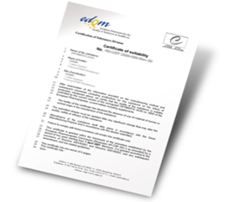
Principles for assessment
Performed against applicable monographs and chapters of the Ph. Eur., applicable ICH and EU guidelines (e.g. on quality of active substances) and applicable EDQM policies
Science- and risk-based – focus on impurities and their control
It is a requirement to show whether the monograph of the Ph. Eur. the substance refers to is suitable to control the quality of the source of the substance under evaluation and to propose appropriate additional specification(s), where relevant
Outcome: an official certificate granted by EDQM: CEP

Slide 15
How long does it take ?
“3-round policy”:
Initial assessment
Letter of questions
Assessment of responses
2nd request for information
Assessment of responses and decision to grant the CEP or to reject the application (or exceptionally a last request for information)
Official deadlines for each milestone
It takes min 5 months and max 1.5 year to get a CEP

Slide 16
Revisions of CEPs
Once a CEP has been granted it must be
maintained throughout its lifetime!

Slide 17
Basic principles for revisions of CEPs
Changes to CEP applications are handled by EDQM
Any change must be reported to EDQM and approved, depending on the nature of the change
Original CEP is valid 5 years
Holder needs to apply for renewal on time
After renewal, CEP valid for an unlimited period, provided the dossier is kept up-to-date
CEP Holder should inform customers of any changes made
If a revised CEP is issued, it has to be sent to customers and a variation to the marketing authorisation application(s) has to be submitted

Slide 18
Basic principles for revisions of CEPs (2)
Based on EU Regulations on Variations to Marketing Authorisations
Specific EDQM guideline for revisions of CEP (EDQM website)
PA/PH/CEP (04) 2, 7R corr, September 2018
Timelines for approval depend on the type of changes
Ph. Eur. monographs are subject to regular updates and this has an impact on CEP applications and on the CEPs themselves
CEPs are not systematically revised after a change.

Slide 19
What to do after approval of a CEP revision?
What to do with a revised CEP
Holder to provide copy to their customers
MAH to update relevant Marketing Authorisation Application(s) (variation) ➔Mandatory
What to do when a change is approved but CEP is not revised
Holder to inform customers, but no variation of the Marketing Authorisation Application
➔Mandatory
Appropriate communication between the CEP holder and their customers is crucial!

Slide 20
Use of a CEP

Slide 21
CEP in a marketing authorisation application in EU
CEP (chemical purity) intended to be included in Part 3.2.S of the Marketing Authorisation Application:
A complete copy of the CEP, with its annexes
Specification of the active substance, which should include the tests mentioned on the CEP
A CEP may not address all parameters relevant for the specific use in the finished product, e.g. specific physico-chemical characteristics, etc. ➔ API specification in the dossier may include additional tests to those of the monograph + the CEP
Batch data in 3.2.S.4 demonstrating compliance with Ph. Eur. monograph and any additional tests on CEP (+ other tests if needed)
If needed, stability data in 3.2.S.7 (NB. in the EU, stability data are not mandatory for substances described in the Ph. Eur., the substance may be tested immediately prior to use)

Slide 22
Key figures

Slide 23
Key figures
More than 7000 CEP applications received for 850 different substances
About 300 new applications every year (mostly for chemical purity)
About 1800 requests for revision every year
More than 95% of applications treated within official deadlines ➔ performance published on a monthly basis
More than 5000 valid CEPs
More than 1200 manufacturers from 50 different countries
About 70 sites/year covered by the EDQM inspection programme (50% inspections, 50% exchange of information)
To date, GMP compliance checked for about 50% of sites located outside Europe

Slide 24
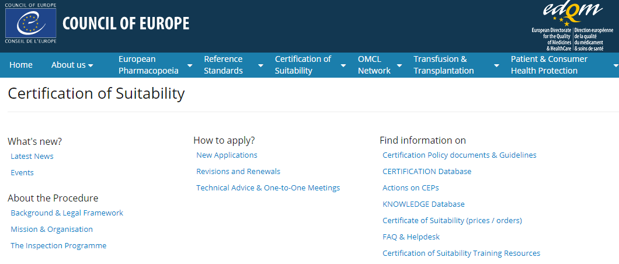
Keep up-to-date with CEP activities
EDQM Website (www.edqm.eu) – Certification of Suitability
Several pages dealing with :
Procedure, news, etc.
A page with actions on CEPs
A page with the list of Certification Policy documents and Guidelines

Slide 25
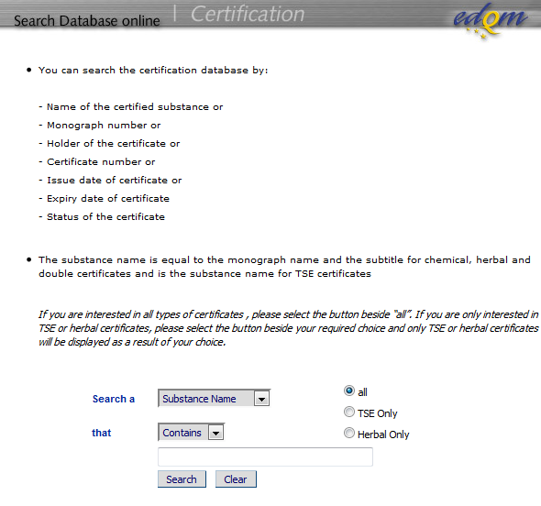
Is a CEP valid…
Possibility to check on the « Certification database » on the EDQM website

Slide 26
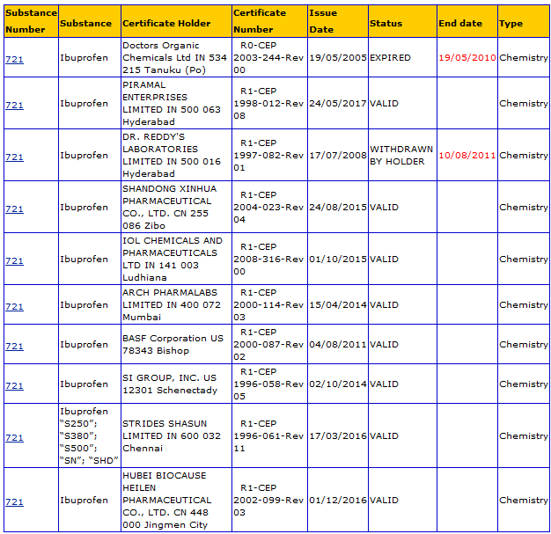
Is a CEP valid…

Slide 27
CEPs & international collaboration worldwide

Slide 28
Use of CEPs worldwide
An increasing number of health authorities worldwide have decided to accept CEPs
e.g. Australia, Canada, Morocco, Singapore, South Africa, TFDA, WHO etc.
CEP often accepted with additional documents. National requirements apply, a number of countries have published guidance on how to use CEPs
Signature of confidentiality agreements/MOUs, to share confidential information, including assessment reports and inspection reports
Regular information on non-compliances with CEP procedure (GMP non-compliance, quality issues etc.)
Sending assessment reports or inspection reports upon request
For assessment reports, prior agreement of CEP holder is needed
Sharing information in case of quality issues (e.g. nitrosamines)

Slide 29
Conclusion
The CEP procedure, as a platform for assessment and GMP inspections, is a powerful and helpful tool
CEPs should be used in an informed way:
A chemical or a herbal CEP certifies that the quality of the substance can be suitably controlled by the Ph. Eur. monograph with addition of tests, if necessary (mentioned on the CEP)
A TSE CEP certifies that the substance complies with the Ph. Eur. General Monograph on Products with TSE risk only
A CEP does not replace testing and is not a certificate of analysis
A CEP is not a GMP certificate
A CEP is not a “carte blanche”
Communication between the CEP holder and the drug product manufacturer is key!

